Slide 1

Technology
store
Data Base Design
Made by Team2

Slide 2

Description (1)
A database for a large-scale technology Store.
The store has employees - either assistant or in the maintenance team
Two separate entities with many to many relationship, a manager is not an employee. Every employee is required to be managed by a manager.
Each order contains items

Slide 3







Description (2)
Items are distributed into subclasses such as TV, AUDIO, ACCESSORIES, IT, KITCHEN, COMMUNICATIONS with different types of technology
Items are delivered to the store by different suppliers
Each item belongs to a brand
The characteristics of the customers are also recorded
Attributes of the warehouses are listed in the data base

Slide 4
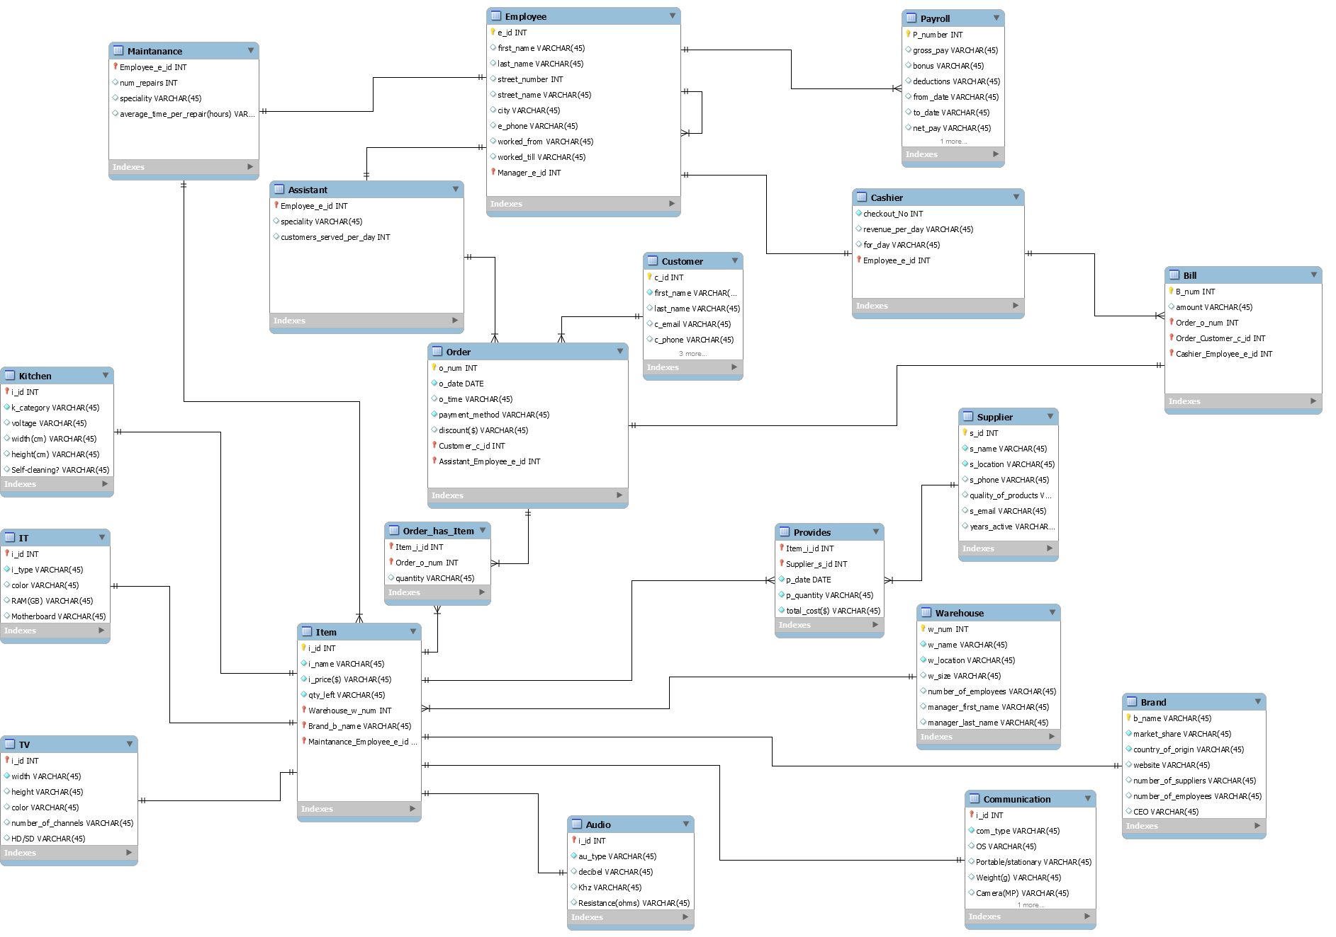
Relational Model

Slide 5




Tools and Technology used
MySQL Workbench
PhpMyAdmin
www.draw.io (EER Diagram)

Slide 6

Sample of Creation
CREATE TABLE IF NOT EXISTS `mydb`.`Employee`
`e_id` INT NOT NULL,
`first_name` VARCHAR(45) NULL,
`last_name` VARCHAR(45) NULL,
`street_number` INT NULL,
`street_name` VARCHAR(45) NULL,
`city` VARCHAR(45) NULL,
`e_phone` VARCHAR(45) NULL,
`worked_from` DATE(45) NULL,
`worked_till` DATE(45) NULL,
`Manager_e_id` INT NOT NULL,
PRIMARY KEY (`e_id`, `Manager_e_id`),
INDEX `fk_Employee_Employee1_idx` (`Manager_e_id` ASC),
CONSTRAINT `fk_Employee_Employee1`
FOREIGN KEY (`Manager_e_id`)
REFERENCES `technology store`.`Employee` (`e_id`)
ON DELETE CASCADE
ON UPDATE CASCADE)
ENGINE = InnoDB;

Slide 7
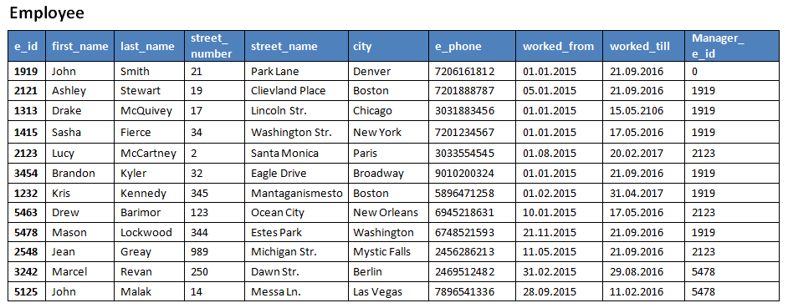
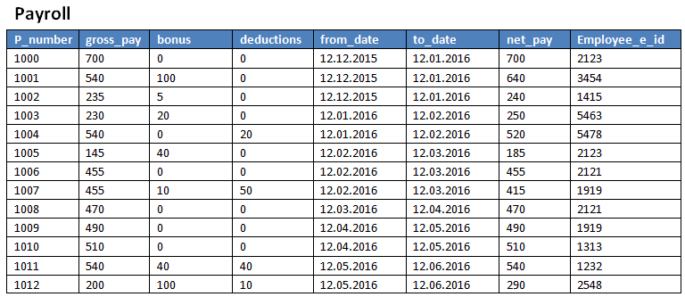
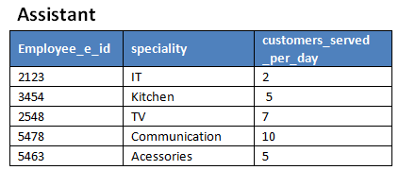
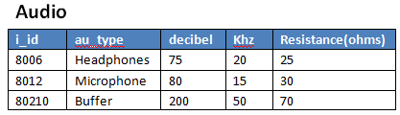

Slide 8
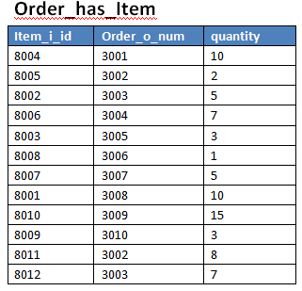
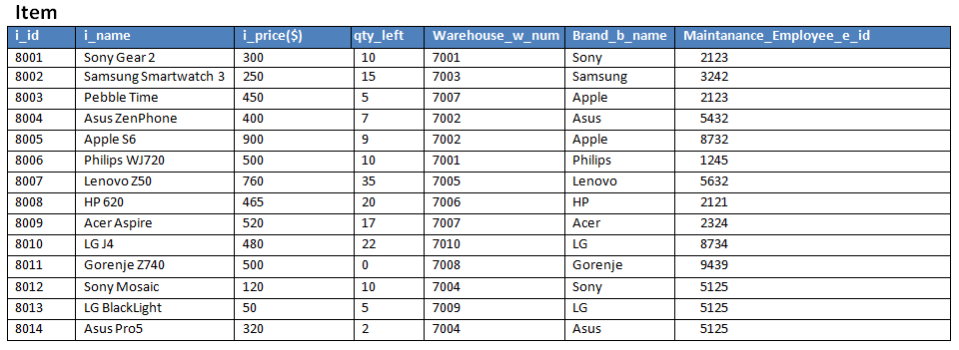
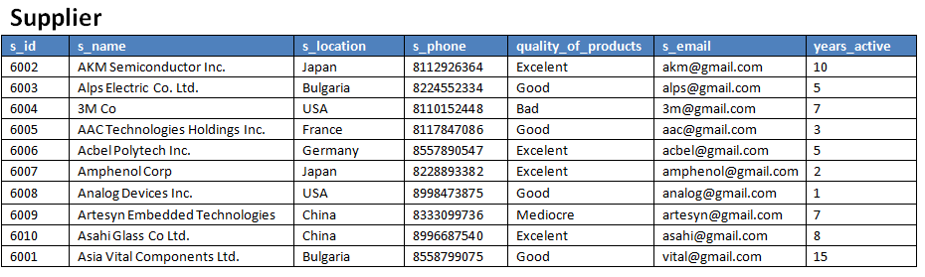
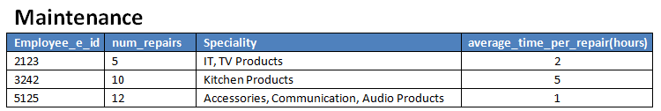
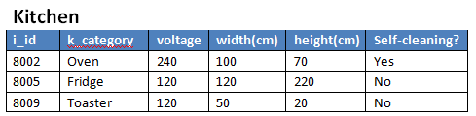

Slide 9
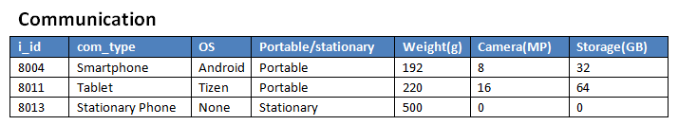
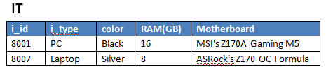
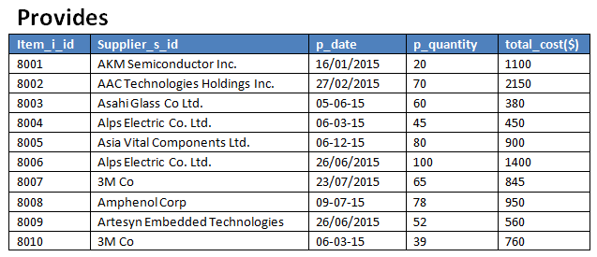
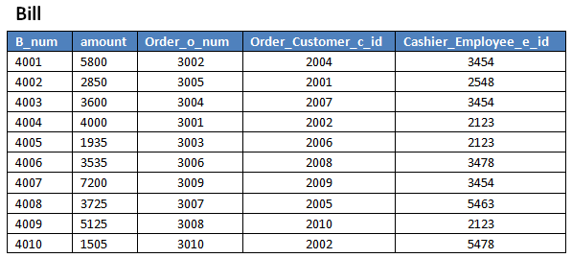
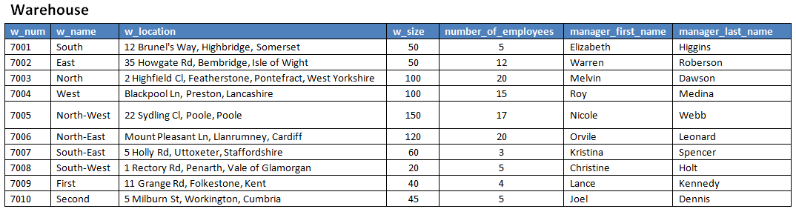

Slide 10
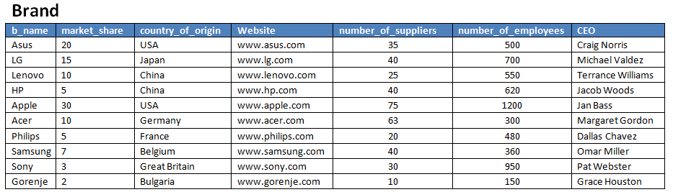
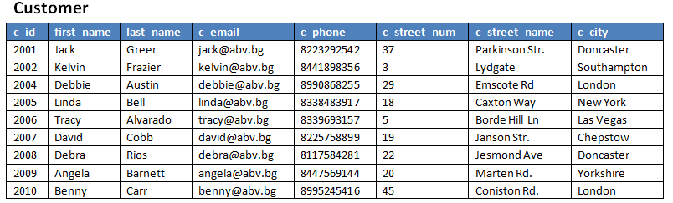
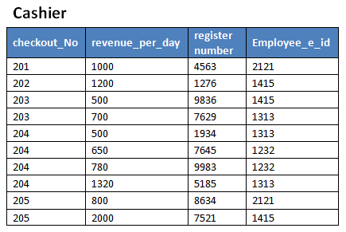
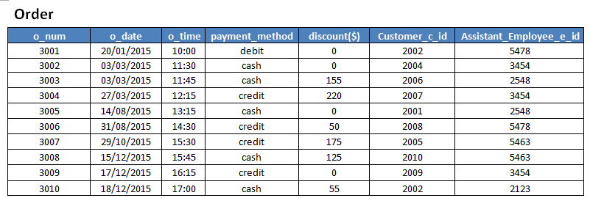
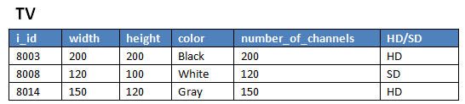

Slide 11
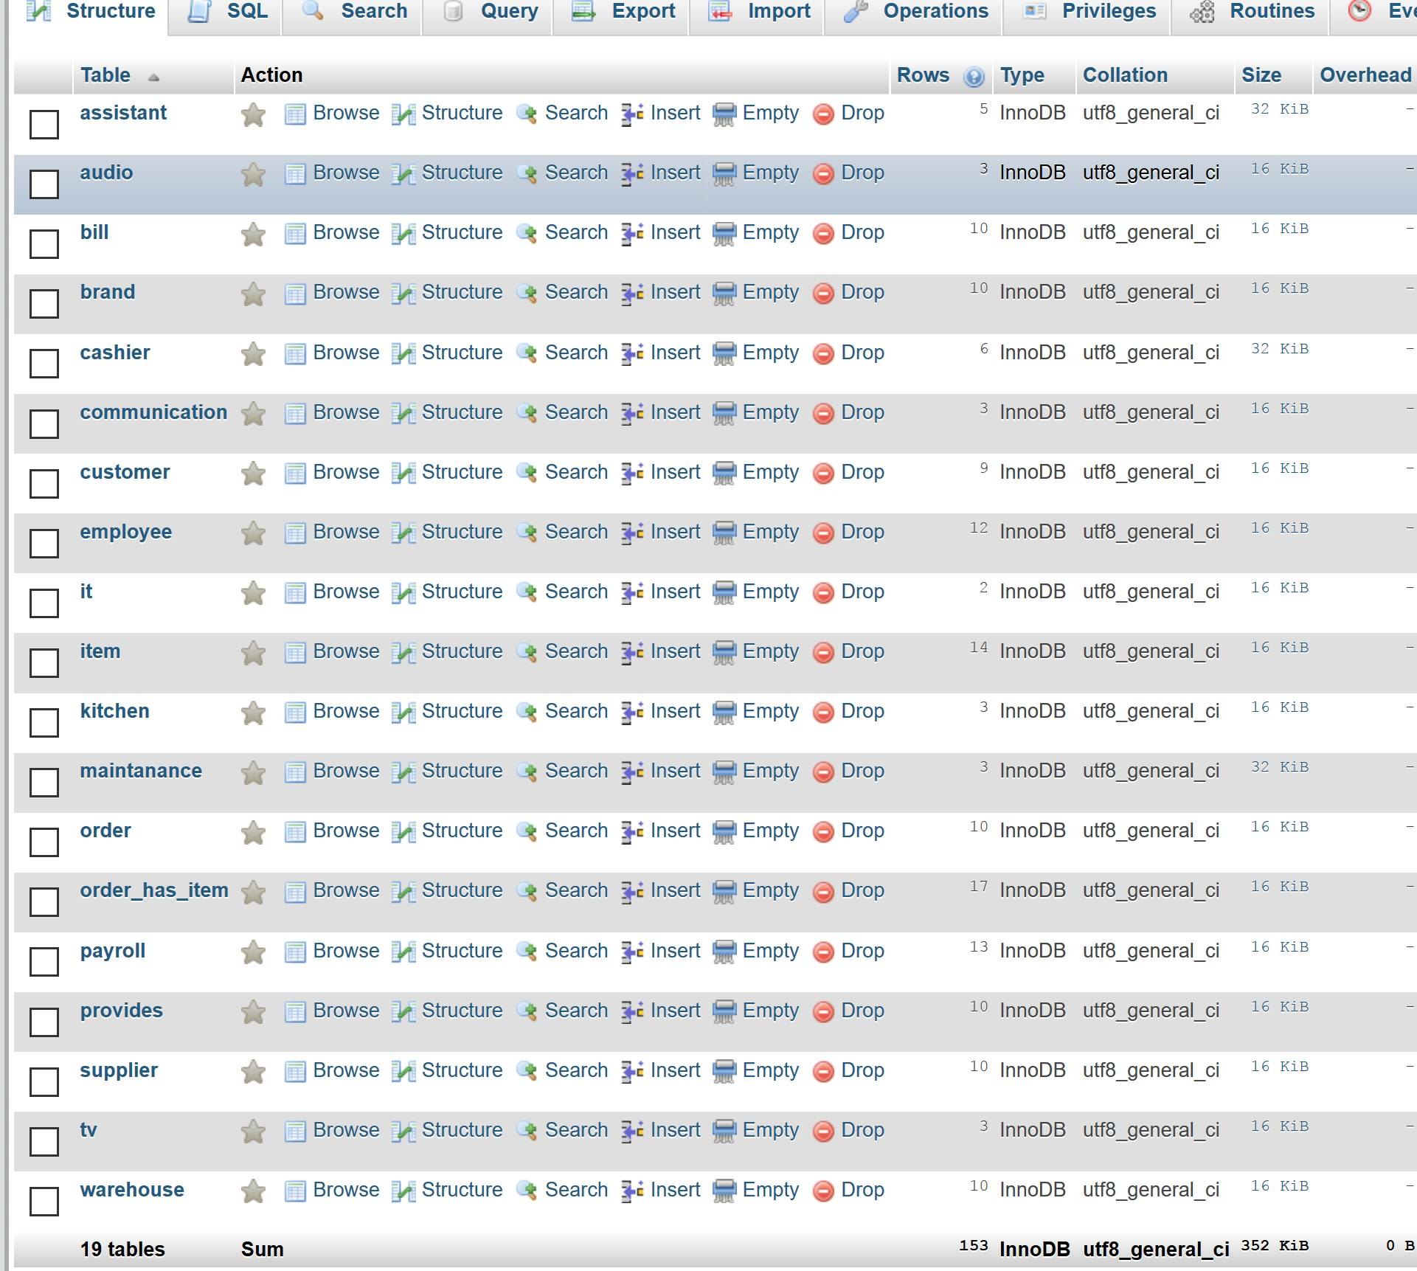

Actual Database

Slide 12
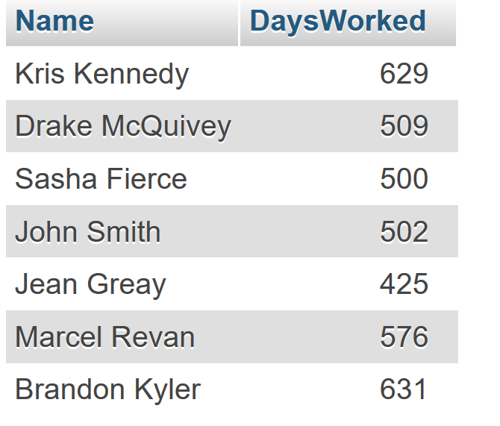
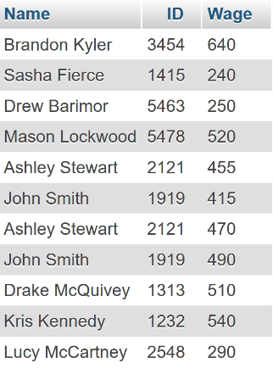
Queries
Query 1: Displays the
employees who worked
for more than a year.
SELECT
CONCAT(`first_name`,' ',`last_name`) As Name,
(DATEDIFF (`worked_till`,`worked_from`)) As DaysWorked
FROM
Employee
WHERE
(DATEDIFF (`worked_till`,`worked_from`)) > 365
Query 2: Displays employees and
respectively their wage.
SELECT
CONCAT(`first_name`,' ',`last_name`) as Name, Employee.e_id as ID , payroll.net_pay as Wage
FROM
Employee
INNER JOIN Payroll
ON Employee.e_id = payroll.Employee_e_id

Slide 13
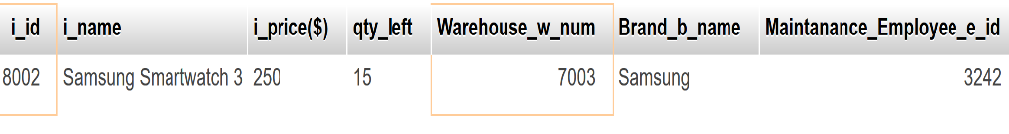
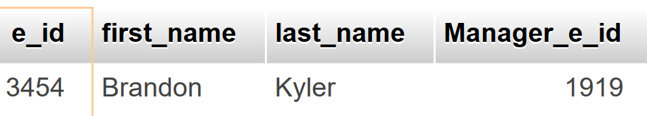
Queries
Query 4: Find all employees who are assistants,
who received a net pay greater than the
average net pay for all employees, and who are
not managers.
SELECT
employee.e_id, employee.first_name, employee.last_name, employee.Manager_e_id
FROM
employee
INNER JOIN
assistant ON (employee.e_id = assistant.Employee_e_id)
INNER JOIN
(SELECT
*
FROM
payroll
WHERE
net_pay > (SELECT
AVG(net_pay)
FROM
payroll)) AS A ON (e_id = A.Employee_e_id)
WHERE
e_id NOT IN (SELECT
manager_e_id
FROM
employee)
Query 3: Find Kitchen items stored in a
warehouse that has more than 10 employees
and that has a size of more than 70.
SELECT *
FROM Item
WHERE
i_id IN (SELECT
i_id
FROM
Kitchen)
AND Warehouse_w_num IN (SELECT
w_num
FROM
warehouse
WHERE
number_of_employees > 10 AND w_size > 70);

Slide 14
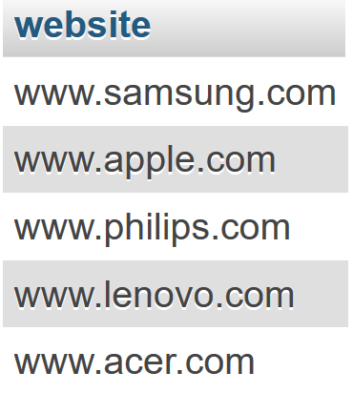
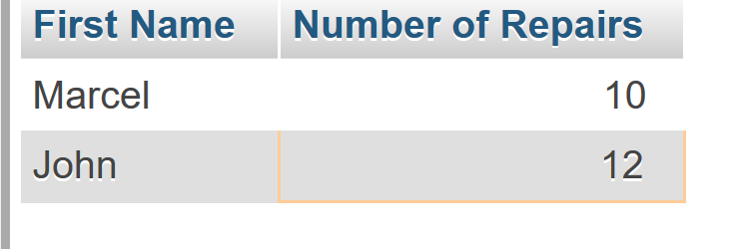
Queries
Query 6: This query has the purpose to show popular brands. A popular brand is one, whose items are being ordered more 2 at a time and are being supplied more than 50 at a time by the supplier. The query shows company websites.
SELECT Brand.website
FROM Brand
INNER JOIN Item
ON Item.Brand_b_name = Brand.b_name
WHERE Item.i_id IN (
SELECT `order_has_item`.`Item_i_id` FROM `order_has_item` INNER JOIN (SELECT `provides`.`Item_i_id`
FROM provides
WHERE p_quantity > 50) as TempProvidesTable
ON `order_has_item`.`Item_i_id` = TempProvidesTable.`Item_i_id`
WHERE `order_has_item`.quantity > 2)
Query 5: Selects the first name of
all maintenance employees with
more than 10 repairs.
SELECT first_name as 'First Name', maintanance.num_repairs as 'Number of Repairs'
FROM
employee
INNER JOIN maintanance
ON maintanance.Employee_e_id = employee.e_id
WHERE
maintanance.num_repairs >= 10

Slide 15
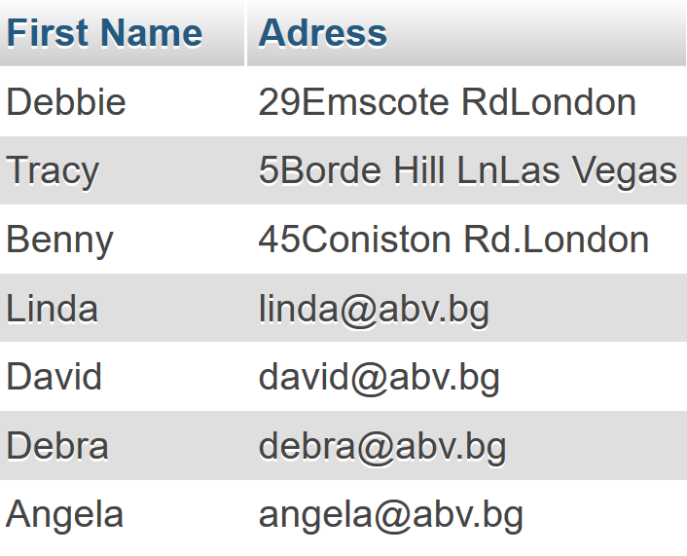
Queries
SELECT customer.first_name As 'First Name', CONCAT(c_street_num,c_street_name,c_city) As Adress
FROM customer
WHERE customer.C_id IN
(SELECT `order`.Customer_c_id
FROM `order`
WHERE `order`.payment_method = 'cash'
AND `order`.o_num IN
(SELECT Order_has_item.Order_o_num
FROM Order_has_item
WHERE quantity > 4))
UNION
SELECT customer.first_name As 'First Name', customer.c_email As 'E-mail'
FROM customer
WHERE customer.C_id IN
(SELECT `order`.Customer_c_id
FROM `order`
WHERE `order`.payment_method = 'credit'
AND `order`.o_num IN
(SELECT Order_has_item.Order_o_num
FROM Order_has_item
WHERE quantity > 4))
Query 7: The company has decided they want to send Christmas cards to their customers – specially preferred customers, who have 4 items in their orders. That being said, people who pay with cash are more likely to check their regular mail, while people who pay with credit cards are more likely to use electronic mail. This query outputs the first name and the address or respectively the e-mail needed for the card sender to make send the cards.

Slide 16
Queries
WHERE
order_has_item.Item_i_id IN (SELECT
i_id
FROM
item
WHERE
i_id IN (SELECT
i_id
FROM
kitchen)
AND Brand_b_name IN ('Apple' , 'Acer'))
AND quantity > 2)
AND EXISTS( SELECT
*
FROM
bill
WHERE
amount > 3000
AND bill.Order_o_num = `order`.o_num))
Query 8: List all clients who ordered more than 2 kitchen items from either Apple or Acer and who paid more than $3000 for their order.
SELECT *
FROM customer
WHERE
EXISTS( SELECT *
FROM `order`
WHERE
customer.c_id = `order`.Customer_c_id
AND o_num IN (SELECT
order_o_num
FROM
order_has_item

Slide 17
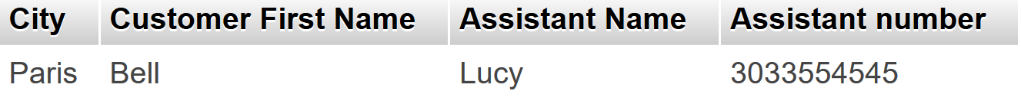
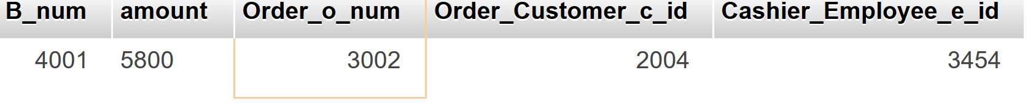
Queries
Query 9: Sum up the amount paid for all orders which include at least two different items with each item having a price over $500.
SELECT *
FROMbill
WHERE
Order_o_num IN (SELECT
order_o_num
FROM
order_has_item
WHERE
Item_i_id IN (SELECT
i_id
FROM
item
WHERE
`i_price($)` >= 500)
GROUP BY Order_o_num
HAVING (COUNT(Order_o_num) > 1));
Query 10 :This query’s purpose is to show customers the assistants who live in their city and are specialists in home-related products(Tv/Kitchen). It displays Customer last name(customers usually are referred by first name) and assistant’ first name (employees use usually first name) who are from the same city . Also that assistant is still working in 2015.
SELECT Employee.city as 'City',customer.last_name AS 'Customer First Name', employee.first_name AS 'Assistant Name', employee.e_phone as 'Assistant number'
FROM Employee
INNER JOIN Customer
ON Employee.city = Customer.c_city
WHERE e_id IN
(SELECT Assistant.Employee_e_id
FROM Assistant
WHERE employee.worked_till < '2016-01-01' AND assistant.speciality IN ('TV','Kitchen'))

Slide 18
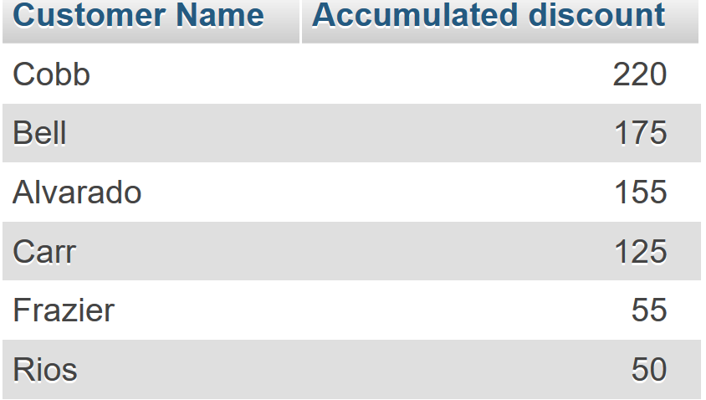
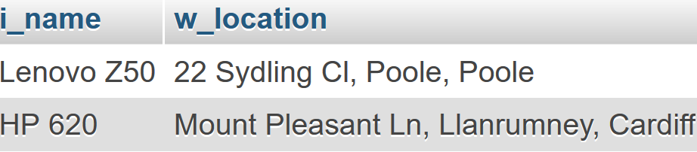
Queries
Query 11 :Shows the accumulated discount by each customer in descenig order
SELECT customer.last_name as 'Customer Name' , SUM(`order`.`discount($)`) as 'Accumulated discount'
FROM customer
INNER JOIN `order` ON customer.c_id = `order`.Customer_c_id
WHERE `order`.`discount($)` > 0
Group BY customer.last_name
Order BY SUM(`order`.`discount($)`) DESC
Query 12:
Where are the items stored now, which are made by a brand from China
SELECT `item`.`i_name`, `warehouse`.`w_location`
FROM `warehouse`
INNER JOIN item ON `warehouse`.`w_num` = item.`Warehouse_w_num`
WHERE `Brand_b_name` IN (
SELECT b_name
FROM `brand`
WHERE `brand`.`country_of_origin` = 'China')

Slide 19

Thank you for your attention

